Slide 1
Measuring Trans-Neptunian Objects with Backyard Telescopes
Steve Kerr
Dave Gault, Hristo Pavlov, Dave Herald, Bruno Sicardy, Felipe Braga Ribas, Julio Camargo, Roberto Vieira-Martins, Josselin Desmars, Alexandre Andrei, Gustavo Benedetti-Rossi, Alex Dias-Oliveira, Marcelo Assafin

Slide 2
The Fringe Dwellers
Trans-Neptunian Objects (less officially Kuiper Belt Objects) orbit beyond Neptune and represent the remnants from the formation of the outer solar system.
Generally dark (comparatively) red coloured surfaces with a higher than usual tendency to be binary objects compared to other solar system bodies ... But many don’t follow this pattern.

Slide 3
Dwarves and Minors (Planets that is)
A range of objects including several Dwarf Planets such as Pluto and many minor planets. Over 1200 objects known depending on strict definition.
Some are in orbital resonances with Neptune (like Pluto) while others are in orbits uninfluenced by the major planets or have been ejected into very large orbits.
They are all a very long way away ...

Slide 4
Occultations as an Observing Tool
From IOTA Observers Manual

Slide 5
Occultations for Amateurs
Occultations are a form of observing well suited to amateurs because …
Modest optics requirements
Modest requirements for recording for high value scientific observations
Value in number of observers and flexibility of times/locations

Slide 6
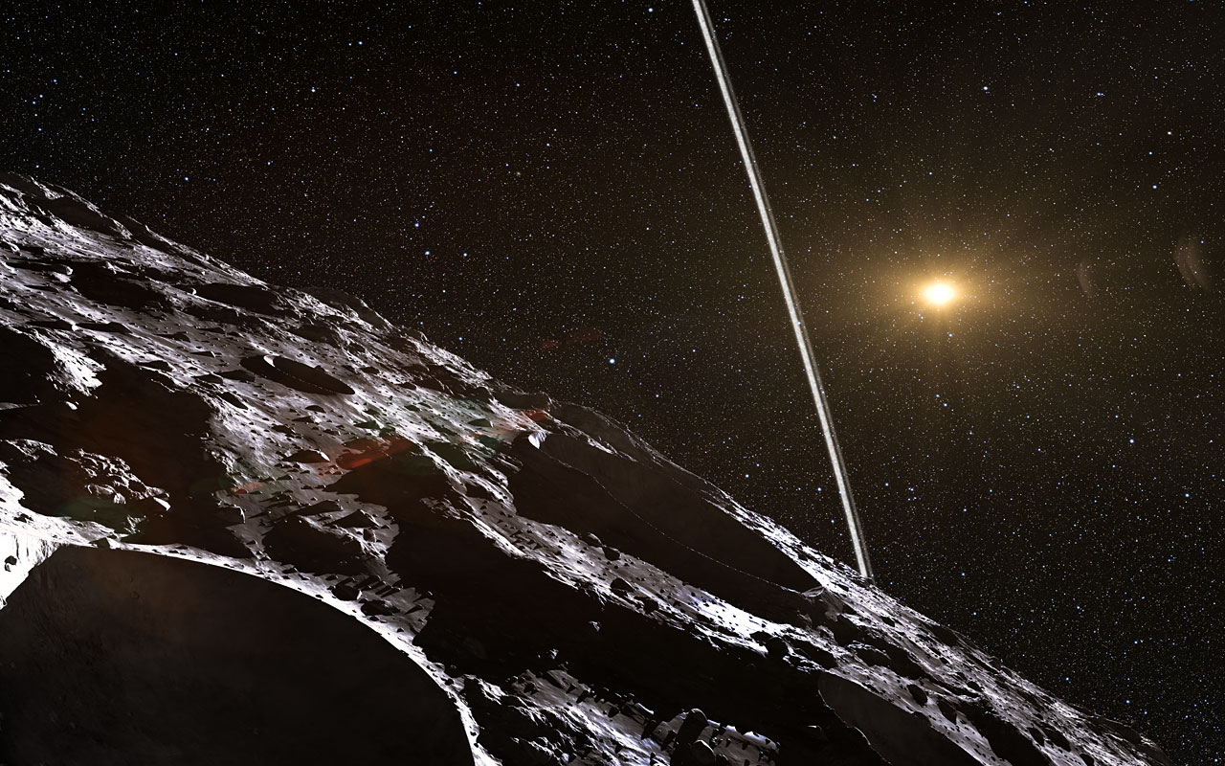
The Science Prize
High precision astrometry
High precision physical dimensions
Presence of satellites/binary objects if lucky
Presence of atmospheres
Presence of rings???
Artists impression of the rings of (10199) Chariklo -
ESO/L. Calçada/Nick Risinger (skysurvey.org)

Slide 7
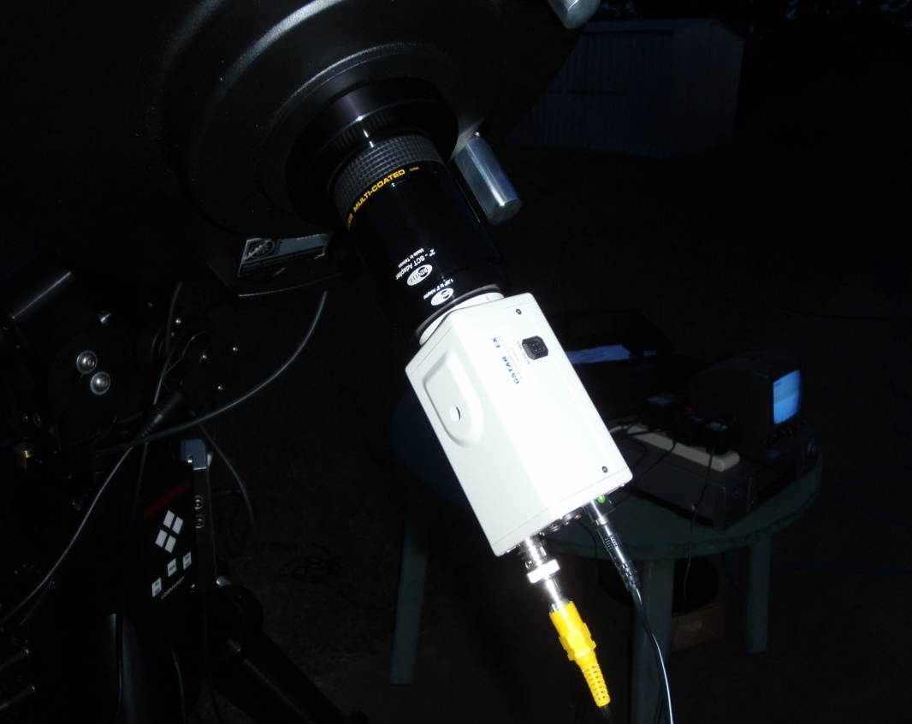
Observing Equipment

Slide 8
Predictions
Not in the same precision league as main belt asteroid occultation predictions.
Spearheaded by a number of professional programs – Primarily, the Rio de Janeiro group.
Primarily geared for professional observing programs – big telescopes, faint stars.
Now available through Occultwatcher.
Stay tuned for Dave Gault’s talk tomorrow ...

Slide 9
Making the Observation

Slide 10
Analysing the Observations
Video photometric software (Tangra or Limovie)
CCD based observations reduced as a time series with particular emphasis on the timing accuracy.

Slide 11
When you get Lucky ...

Slide 12
Crowd Sourcing
From Sicardy et al. DPS08

Slide 13
Prediction

Slide 14
(208996) 2003 AZ84
Large TNO – A Plutino (in a 3:2 resonant orbit with Neptune like Pluto)
Discovered by Trujillo and Brown in 2003
A range of estimates of diameter based on brightness and IR spectra – 686km to 910km ... Clearly some room for improved measures
A satellite estimated at 68km diameter discovered in 2007 using Hubble – mag 25 at a separation of 0.22 arc seconds – observation hasn’t been repeated!
Single chord occultation observed from La Silla in Chile in 2011 – gives a minimum diameter of 573km and no evidence of an atmosphere
Three chord occultation observed from Israel and India in February 2012 – show that 2003AZ84 is far from spherical!

Slide 15
From Braga-Ribas et al. DPS #44

Slide 16
Blockbuster!
(video of occultation to be inserted)

Slide 17
...analysis

Slide 18
Other observations

Slide 19
Conclusions
Doesn’t really add much to the diameter determination
No confirmation of the satellite
Data quality barely able to confirm the absence of an atmosphere
Three separate occultations give improved astrometry ... So future occultation prediction precision should start to improve.

Slide 20
The Future
... Which is where you come in...
Amateur telescopes spread across the world chasing those identified occultations within their reach can answer these questions.

Slide 21
References and Further Reading
Braga-Ribas et al. A ring system detected around the Centaur (10199) Chariklo; Nature, 2014, vol. 508, p. 72-75
Sicardy et al. CONSTRAINTS ON CHARON’S ORBITAL ELEMENTS FROM THE DOUBLE STELLAR OCCULTATION OF 2008 JUNE 22; The Astronomical Journal 141:67 (February 2011)
Braga-Ribas et al. Stellar Occultations by TNOs: the January 08, 2011 by (208996) 2003 AZ84 and the May 04, 2011 by (50000) Quaoar; Vol. 6, EPSC-DPS2011-1060-1, 201
Braga-Ribas et al. Stellar Occultations by Large TNOs on 2012: The February 3rd by (208996) 2003 AZ84, and the February 17th by (50000) Quaoar; American Astronomical Society, DPS meeting #44, #402.01
RASNZ Occultation Section Website - http://www.occultations.org.nz/planet/2013/results/20131202_208996_2003_AZ84_Rep.htm
http://en.wikipedia.org/wiki/%28208996%29_2003_AZ84
Lakdawalla E., Pluto and the Kuiper Belt: Austalian Sky and Telescope April 2014 (also published in Sky and Telescope (US) Feburary 2014)
Occultwatcher - http://hristopavlov.net/

